Slide 1
GEORGIA OFFICE OF VICTIM SERVICES

Slide 2
Georgia Office of Victim Services
Representing
State Board of Pardons and Paroles
Department of Corrections
Department of Community Supervision

Slide 3
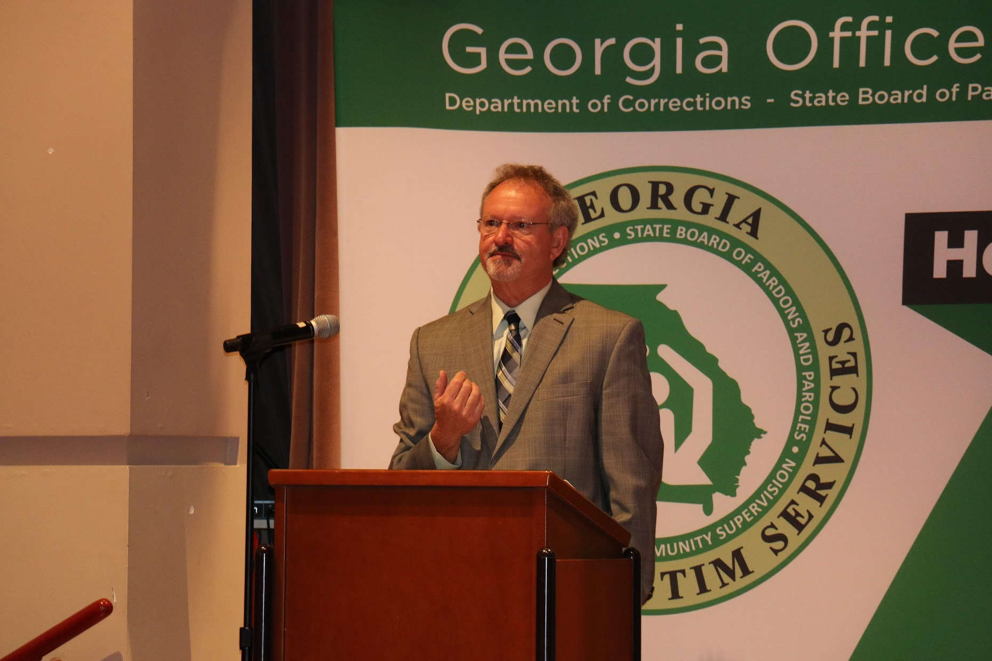
Georgia Office of Victim Services
Mission Statement
To provide post sentencing support and information to crime victims, their families, and members of the community.

Slide 4
Georgia Office of Victim Services
The State Board of Pardons and Paroles is recognized for its leadership role in advocating of victims' rights
In 2005, the Parole Board and Department of Corrections combined their offices of victim services to form the Corrections and Parole Board Office of Victim Services
This afforded both agencies the opportunity to accommodate victims by providing the highest level of customer service
On July 1, 2015, with the creation of the Department of Community Supervision, the office began serving victims for all three agencies and is now the Georgia Office of Victim Services

Slide 5
Georgia Office of Victim Services
Statutory Requirements
O.C.G.A. § 17-17-13
O.C.G.A. § 42-9-47
O.C.G.A. § 42-1-11 (b)
O.C.G.A. § 17-10-1 (5) (b)
O.C.G.A. § 42-3-5
O.C.G.A. § 17-10-1

Slide 6
Georgia Office of Victim Services
Crime victims, their families, and members of the community can initiate the registration process by sending at least one of the following:
Victim Impact Statement
Victim Notification Request Form
Protest Letter
Any written correspondence to the Georgia Office of Victim Services to request notifications
All documents can be forwarded to the Office of Victim Services via postal mail, electronic mail, online forms, fax, or hand delivery
Once registered, written confirmation of registration will be provided along with a personal identification number (PIN)
Using their PIN, victims can access the Georgia Victim Information Program (an automated 24/7 phone line) to receive their offender’s current incarceration location, parole status/eligibility, or the scheduled release date

Slide 7
Georgia Office of Victim Services
Types of Notifications
Registered victims will receive the following notifications, when applicable, regarding their offender(s):
Parole Considerations
Final Decision – 72 Hour Notice
Custodial Status
Release from Custody
Medical Reprieve
Compassionate Reprieve
Work Release consideration
Escapes and recaptures
Inmate deaths
Pardon Considerations

Slide 8
Georgia Office of Victim Services
Restitution
The Georgia Office of Victim Services serves as the liaison between crime victims and the Department of Community Supervision to address restitution-related matters
Restitution is court-ordered monetary compensation for crime victims
A legitimate order for restitution is applied during the sentencing of an offender, and the amount and manner of payment are determined by the courts
Once an offender is under community supervision, officers facilitate and monitor offender restitution payment compliance

Slide 9
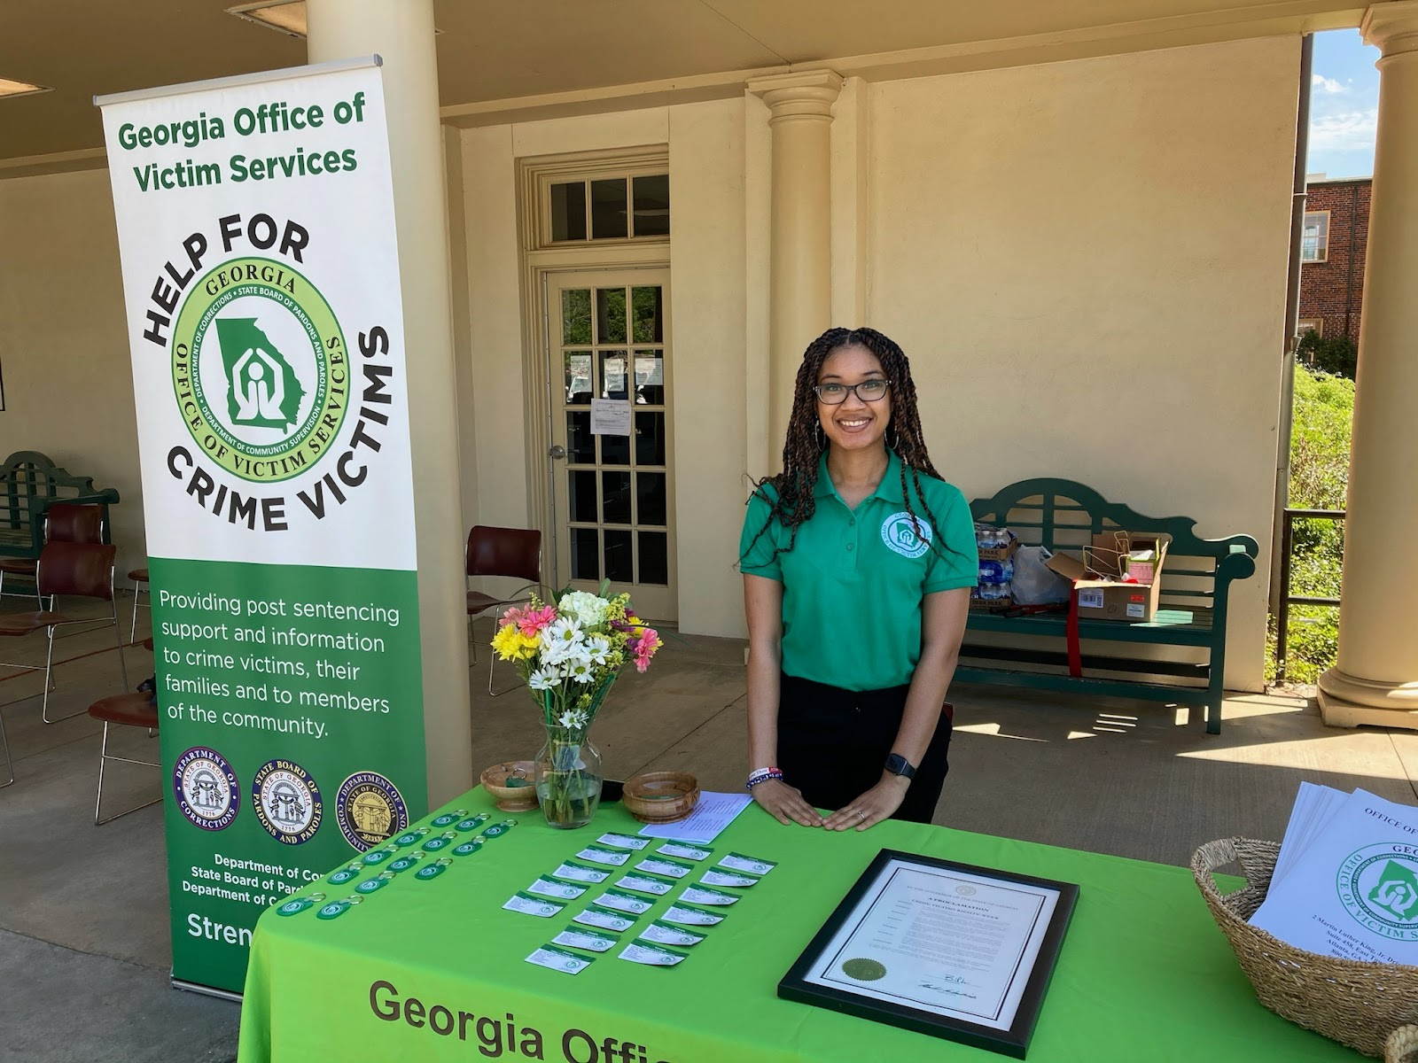
Georgia Office of Victim Services
Assistance and Programs
Victims Visitors' Day - VVD
Victim Offender Dialogue - VOD
Victim Support Partners - VSP
Unwanted Communication

Slide 10
Georgia Office of Victim Services
Victims Visitors’ Day (VVD)
Victims Visitors’ Day is a partnership between the Georgia Office of Victim Services and District Attorney’s Victim Witness Assistance Programs throughout the state
Crime victims can voice the impact of the crime, receive information concerning the current status of the offender and can register to receive future notifications regarding the status of the case
Since 2006, the Georgia Office of Victim Services has hosted more than thirty separate events, serving thousands of crime victims and their family members
VVD provides a unique opportunity for crime victims to meet face to face in a confidential setting to discuss their case with Parole Board members and or the leadership/decision-makers from each of the agencies that the Georgia Office of Victim Services represents

Slide 11
Georgia Office of Victim Services
Victim Offender Dialogue (VOD)
VOD is a victim-centered/victim-initiated program that provides an opportunity for victims to have a structured, safe, one-on-one meeting with their offender, while in the Department of Corrections custody or in some cases while serving community supervision

Slide 12
Georgia Office of Victim Services
Victim Support Partners (VSP)
VSP is a statewide network of dedicated victim-volunteers who aid, guide, and comfort victims and their families
Support includes, but is not limited to:
Sharing information about the Parole process
Helping to identify victim’s needs
Assisting with victim registration and impact statements
Participating in Georgia Office of Victim Services sponsored events
Serve as guest speakers at community meetings
Promote restorative justice themed programs

Slide 13
Georgia Office of Victim Services
Unwanted Communication
The Georgia Office of Victim Services serves as a liaison between crime victims, the State Board of Pardons and Paroles, the Georgia Department of Corrections, and the Department of Community Supervision when receiving unwanted, threatening, and harassing contact by an offender(s)

Slide 14
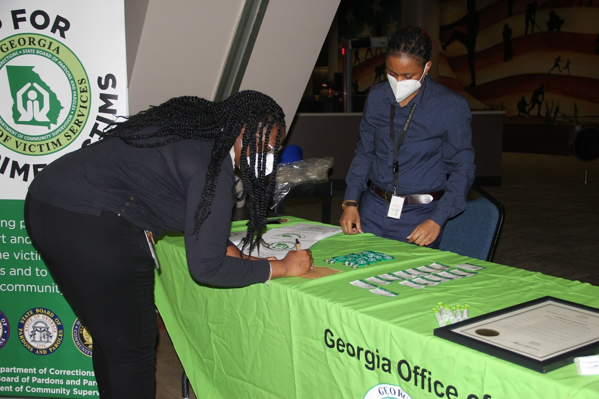
Georgia Office of Victim Services
Contact Information
Office Number: 404-651-6668
Toll Free Number: 1-800-593-9474
Fax: 404-465-3567
Email: victimservices@pap.ga.gov
https://www.facebook.com/gavictimservices

